Slide 1


Evaluating Thresholds for Errors Detection and Correction by Using a Game Task
Supervisor- Dr Anat Dahan
Students- Koral Ben David Jacob Tal Cohen
Notes:
קורל

Slide 2
Background
Monitoring and adjusting our performance are crucial for adaptive behavior.
Threshold for error detection and correction
The effect of ADHD on error detection and correction
Examine the extent of PES in participant with ADHD vs patients
without ADHD.
Notes:
קורל
Let's start with some background on what topics our project deals with, first:
Monitoring and adjusting our performance are crucial for adaptive behavior. It is a key component of human cognitive control.
Motor errors can stem from a variety of factors, such as, lack of motor planning, coordination, deficiencies in sensory feedback and wrong timing.
One widely studied metric of this behavior is post-error slowing (PES), the finding that humans tend to slow down their performance after making an error.
Our motivation is to solidify the connection between ADHD and Error Detection monitoring, focusing on Motoric and Kinematic errors. We will do it By researching post-Error slowing presented by people with and without ADHD

Slide 3
Error Detection Monitoring
What is it?
A cognitive process by which individuals can identify and detect errors or mistakes in their actions, or behavior
Error Detection threshold
Is there a threshold for detecting and correcting errors, and what is it?
Notes:
קורל
Error detection monitoring
It is the ability to self-monitor and recognize when something is incorrect or inaccurate with our actions or their results.
It can occur in various cognitive domains, such as perception, memory, and in our case motor skills.

Slide 4
Post error slowing
ADHD and Error Detection
Attention Deficit Hyperactivity Disorder (ADHD) is a common mental disorder that interferes with day-to-day activities.
Studies showed that people with ADHD have a limitation in their ability to detect and monitor errors.
A cognitive phenomenon where individuals tend to exhibit slower response times and more careful behavior and actions following an error or mistake on a task.
Notes:
קורל
ADHD, or Attention-Deficit/Hyperactivity Disorder, is a neurodevelopmental disorder with symptoms such as inattention, impulsivity, and hyperactivity.
Studies have found that people diagnosed with ADHD may experience difficulties in the error detection process
They may struggle to recognize and respond to mistakes, resulting in challenges in adjusting behavior and improving performance.

Slide 5
Our Project
An interactive game that will collect and analyze data from test subjects to examine the threshold of error detection and correction
Notes:
קורל
So how we going to to do it?
Before we expand on the theoretical background, we will briefly introduce our project.
We will develop an interactive mobile app that will collect and analyze data from test subjects to examine the PES phenomenon.
The test subject will perform a motor task of moving a car by his finger along a track, the application will create errors in his movement and collect data on it to check his response.
And after a short briefing, Tal will continue with the theoretical background.

Slide 6

Our research
What is the Error Detection threshold of
people in general in our game?
Does that threshold differ from people diagnosed with ADHD ?
Will we reproduce the Post Error Slowing phenomenon in our task ?
Notes:
קורל
Our research focused on 3 main questions-
First, Will we reproduce the Post Error Slowing phenomenon in our task?
Studies have already proven that the phenomenon exists, our goal is to create a motor task that will succeed in reproducing this phenomenon.
Second, what is the Error Detection threshold of people in general?
Do people react differently to small and big mistakes? Is it something relatively constant or does it vary greatly from person to person?
And the last one, does that threshold differ from people diagnosed with ADHD?
How do people with ADHD react to these errors? Is it different from undiagnosed people?
Is the phenomenon of PES different between diagnosed and non-diagnosed?

Slide 7
Our Product
Tool that will help us to understand and solidify the Error Detection and correcting threshold and the connection to ADHD
Performance of a motor task by the test subject with artificial errors created by the system
Data collection and kinematic measures
Data analysis and conclusions
Notes:
קורל
Our solution for these 3 questions Is to develop a tool based on 3 main levels.
First, develop a motor task that will be performed by a test subject. The system will create artificial errors.
After that, the data collection and analysis phase will be carried out using various kinematic metrics.
At this stage the system will examine whether to increase/decrease the errors in the next round of the task execution.
The final step will include the option to view the data collected and to assigning a subject to a group.
At this stage we can learn about the threshold of error detection, the phenomenon of post error slowing and ADHD.

Slide 8
Our Product - System & Game Task
Control a vehicle using arrow keys
5 rounds - each containing a different error size
Collect data continuously
Analyzing the data after completing the task
Notes:
קורל

Slide 9
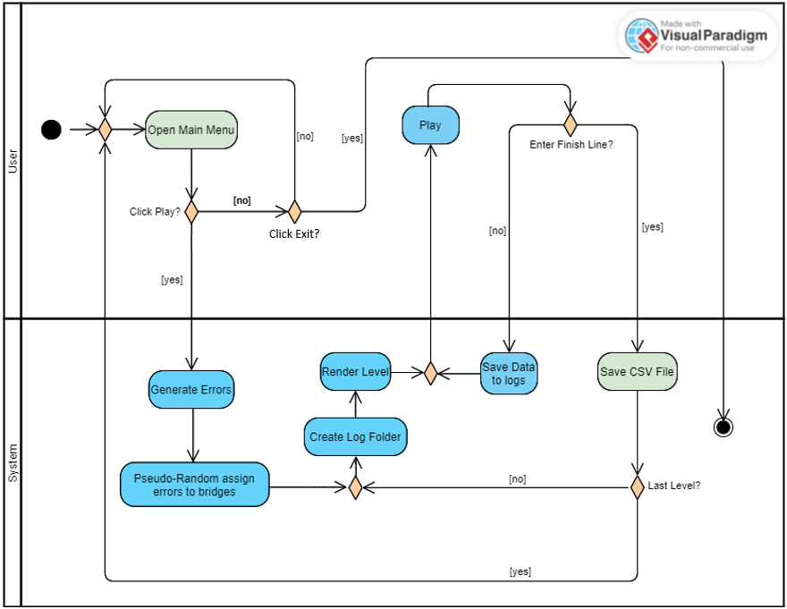
Activity Diagram
Notes:
קורל

Slide 10
Development Process
Developed in the Unity Engine, utilizing its physics engine and models
Iterative Testing Cycle
Collection and storage of data in log files
Data parsing and storing in CSV files
Data visualization
Notes:
טל

Slide 11
Unity Engine
Cross-platform game development engine
Highly optimized rendering of graphics and scenes
Control input firmware - mouse, keyboard, joystick
Notes:
טל

Slide 12
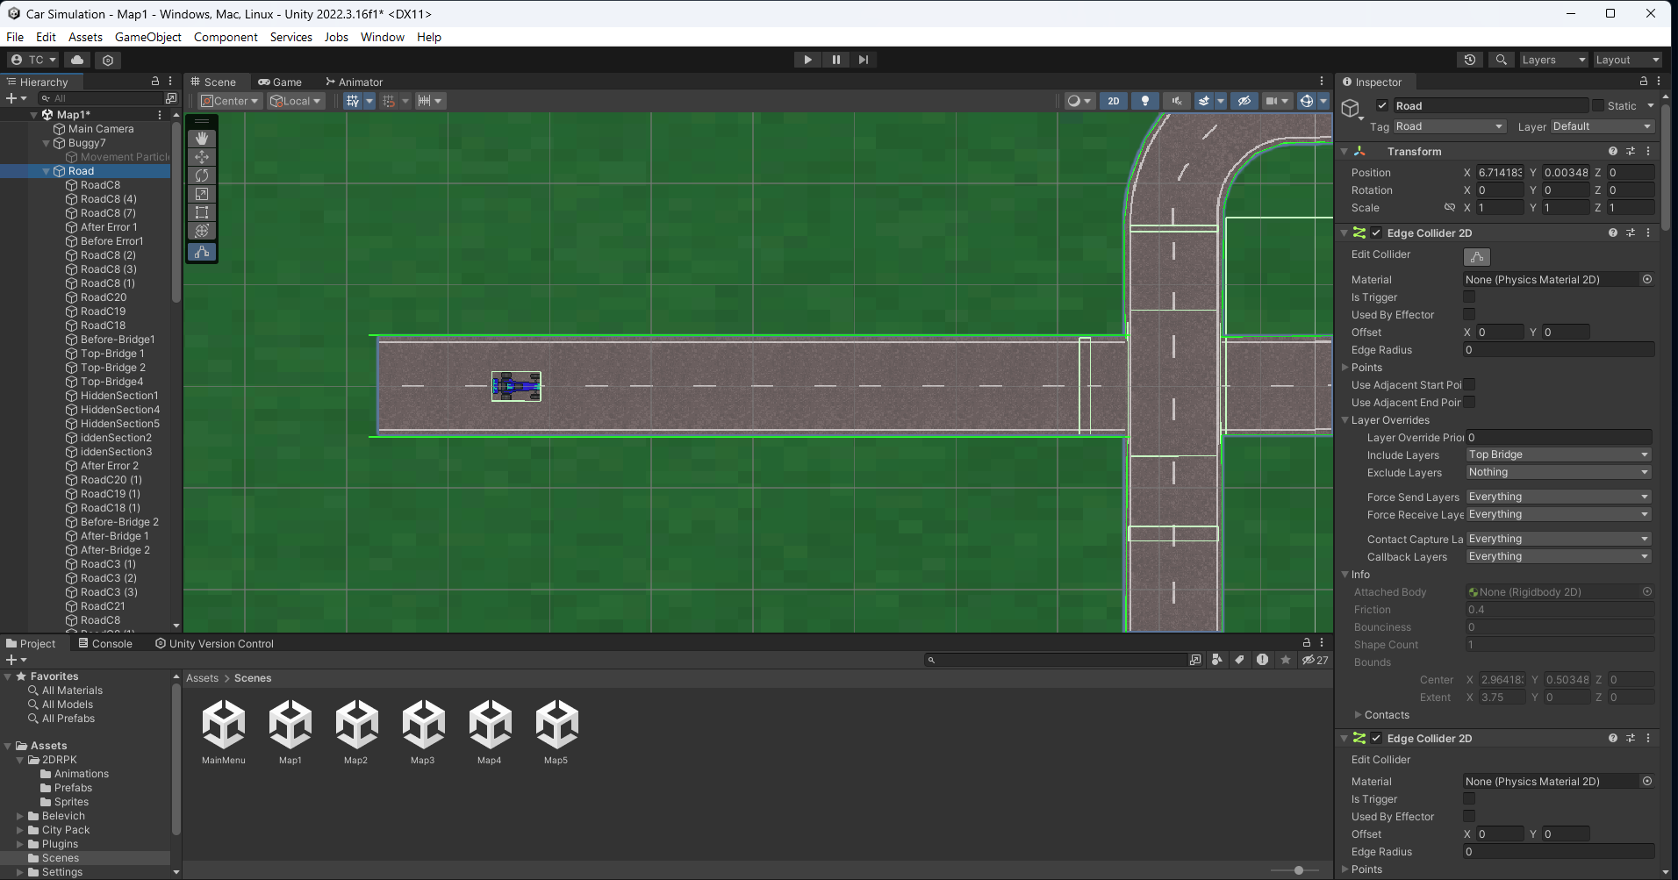
Unity’s Physics Engine
Rigidbody Components
Colliders
Forces and Impulses
Notes:
טל

Slide 13
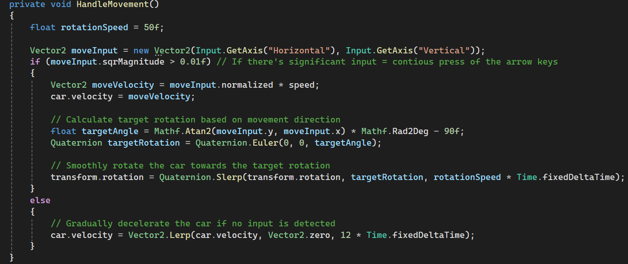
The System and Game Task
Notes:
טל

Slide 14
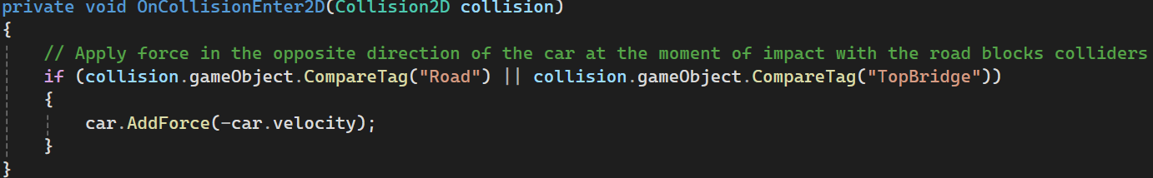
The System and Game Task
Notes:
טל

Slide 15
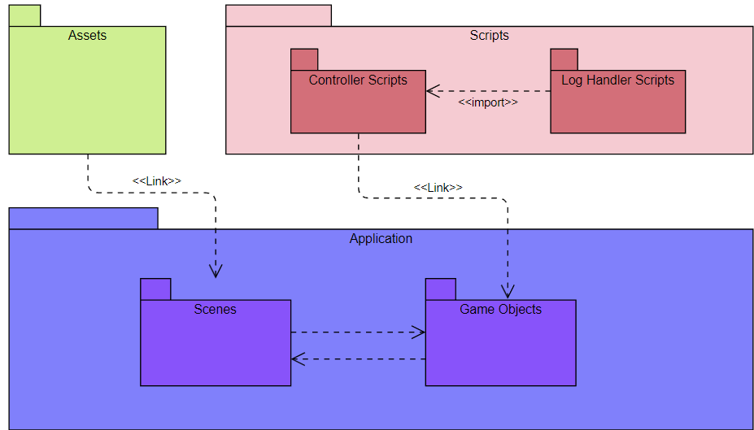
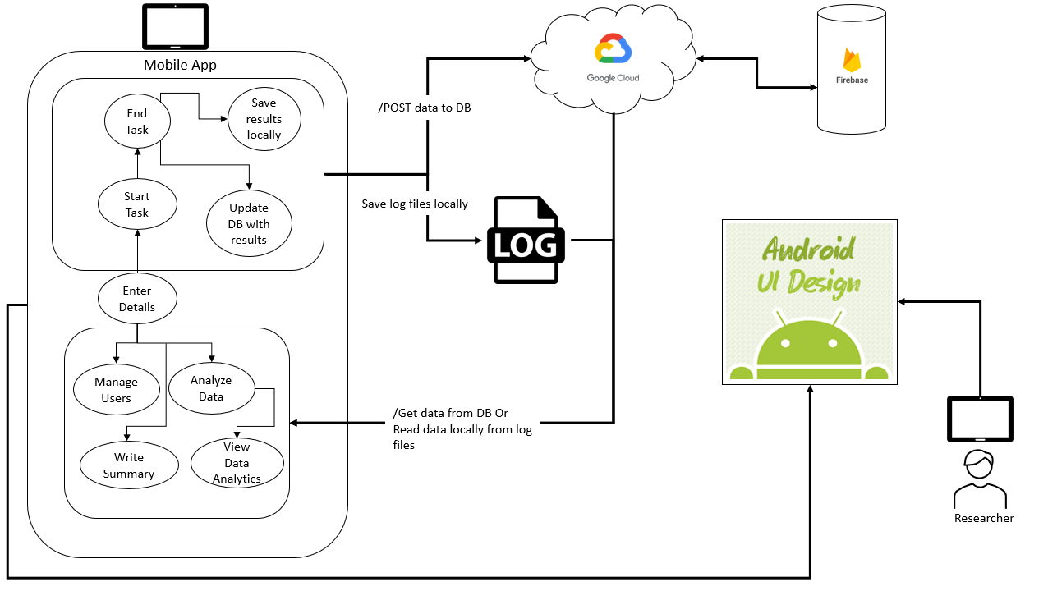
Package Diagram
Notes:
טל

Slide 16
Testing Cycle - Software Testing
Colliders blocking and event dispatching
Data collection and logging
Inducing artificial errors
Momentarily hiding the car from view
Notes:
טל

Slide 17
Testing Cycle - Usability Testing
Test group of 5 individuals 23-30 years old
Changed the car’s control from cursor-based to keyboard-based
Adjust Error Sizes
Defining errors correction & detection
Notes:
קורל

Slide 18
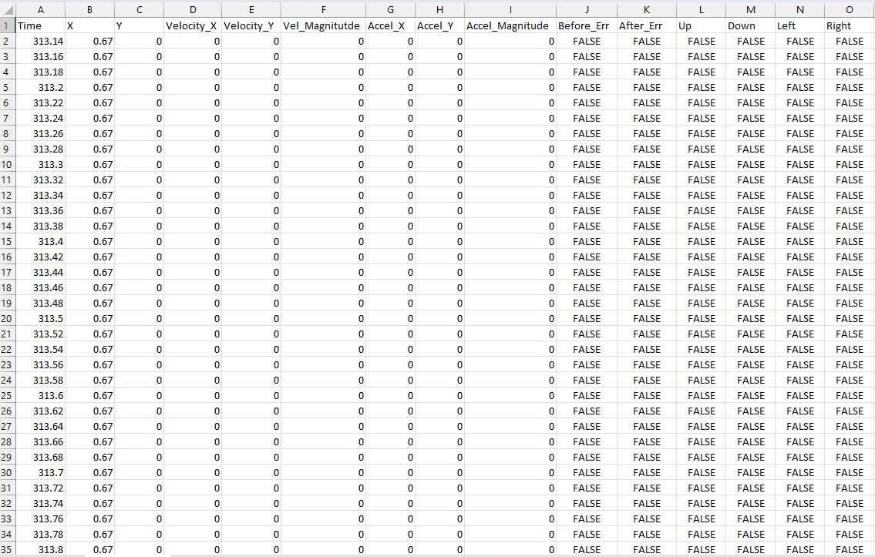
Log Files
Data Log
Timestamp
X, and Y coordinates
Velocity
Acceleration
Before_Err
After_Err
UP, DOWN, LEFT, RIGHT
Notes:
קורל

Slide 19

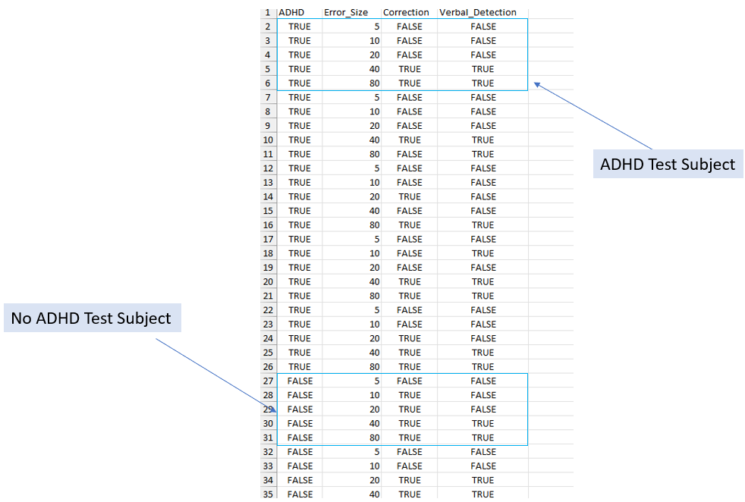
Log Files
Error Size Log
Insights Log
Err_Bridge
Err_Size
Movement_Direction
ADHD
Err_Size
Correction
Verbal_Detection
Notes:
קורל

Slide 20
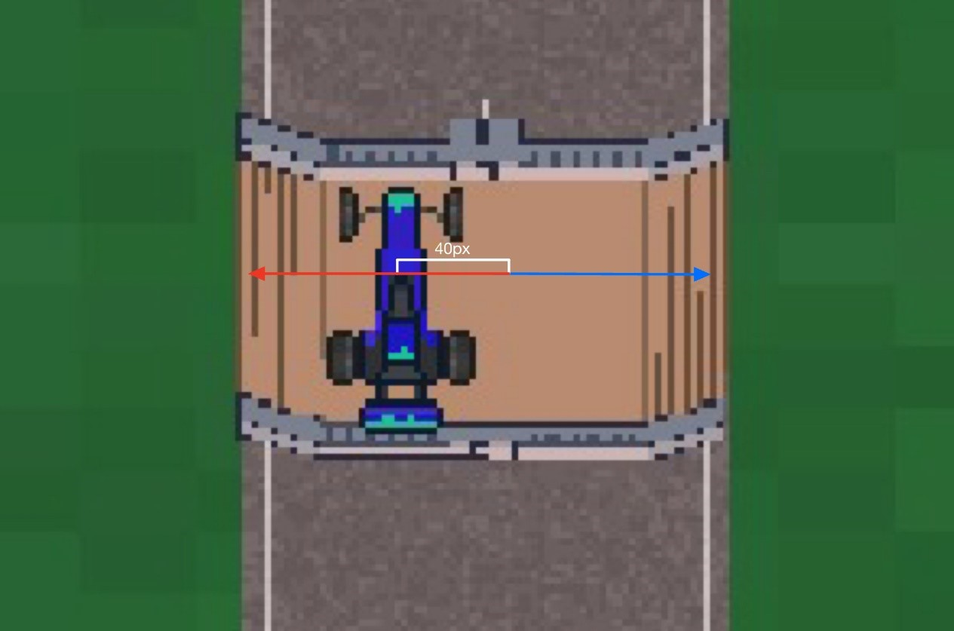
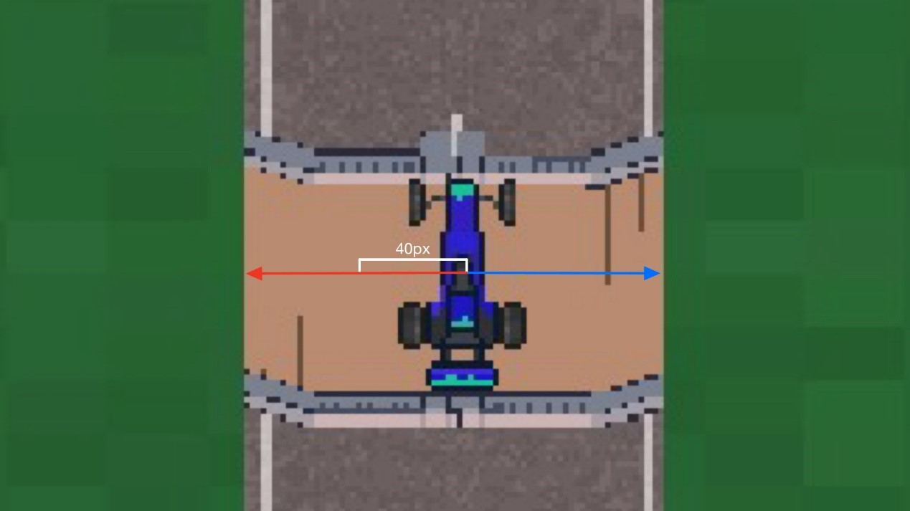
Artificial Errors
Change the position of the car when hidden from view
Error intensity range from 5%-80%
Pseudo-randomization of error location
After
Before
Notes:
טל

Slide 21
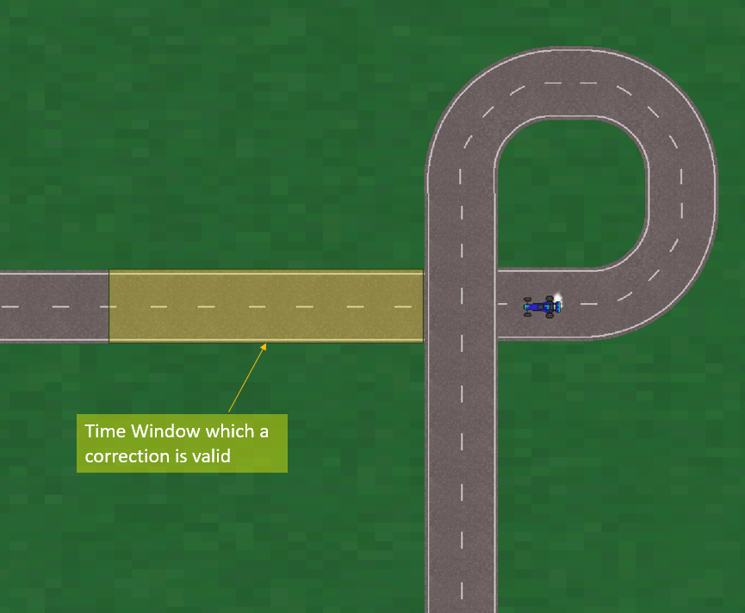
Artificial Errors - Correction
Notes:
טל

Slide 22
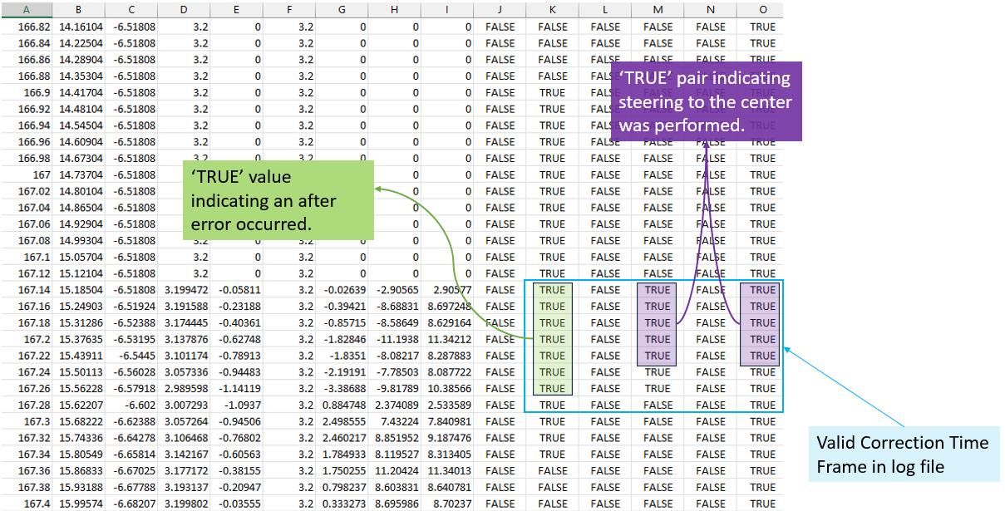
Correction exhibited in Data Log
Notes:
טל

Slide 23
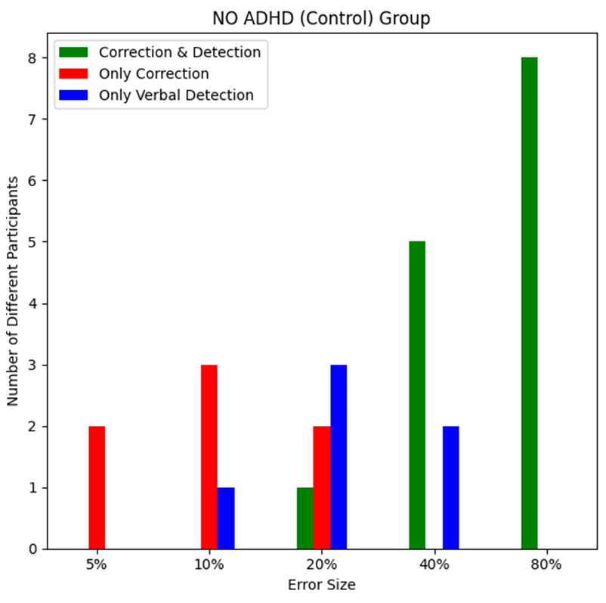
Results
Notes:
קורל

Slide 24
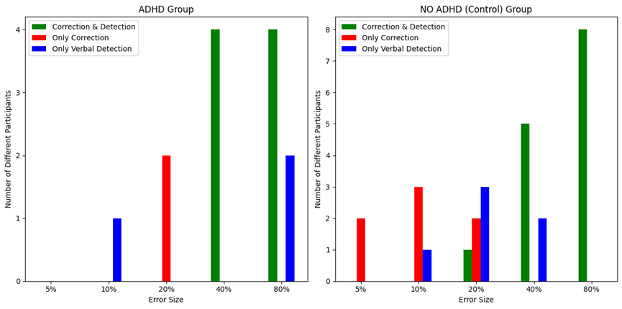
Results
Notes:
קורל

Slide 25
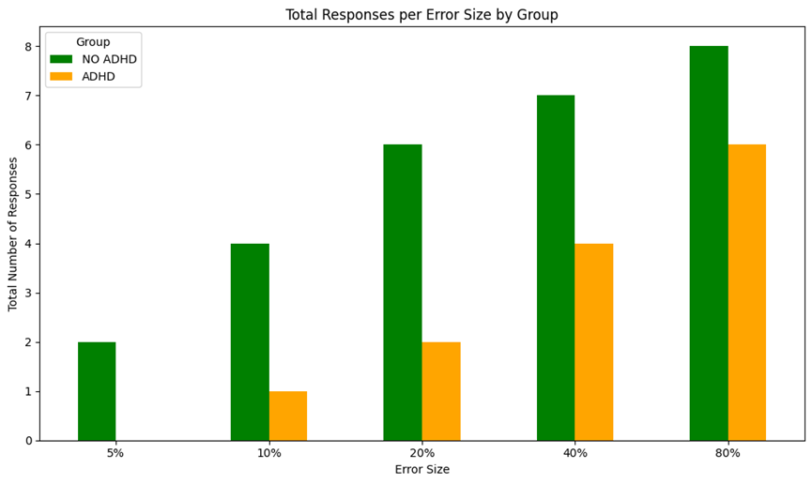
Results
Notes:
קורל

Slide 26
Conclusions
There is a threshold for detecting and correcting errors
People with ADHD have a higher threshold
Notes:
קורל - לכי למה שרשמתי בספר פרויקט תוסיפי בהסבר את החלקים שם על הקשב ותשומת לב לפרטים ושינויים

Slide 27

Challenges
Change development environment
Changing the vehicle movement model
The task did not reproduced the post error slowing phenomenon
Notes:
טל

Slide 28
Notes:
טל

Slide 29

Thank you for listening!

